Slide 1
Substance use disorder
in China
PRESENTED BY
151080001 蔡兆钦 151080023 李芷莹
151080072 钟冰怡 151106009 刘清宇

Slide 2




Slide 3
1
Substance Addiction
in Ancient China

Slide 4
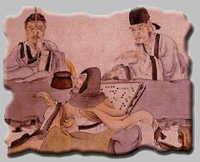
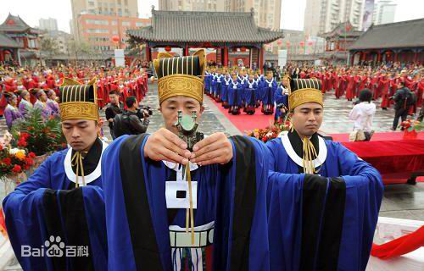
Alcohol Use in Ceremony
In traditional Chinese religious and sacrificial ceremony, wine is used as the carrier to pray for god's blessing on the human welfare and to cherish the memory of ancestors, deceased relatives and friends.
In interpersonal etiquette, the wine is very important. When proposing a toast, the elder comes first.
《前汉书·食货志第四下》: “百礼之会，非酒不行。”
“青梅煮酒论英雄”

Slide 5
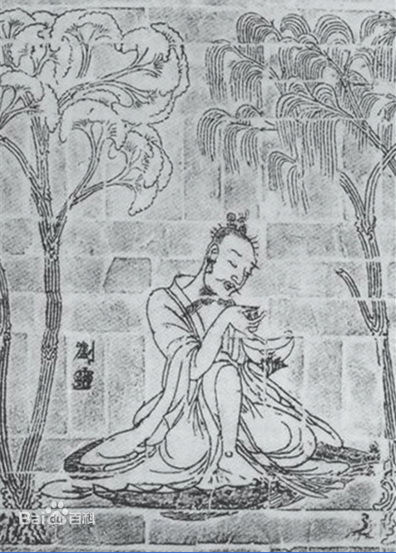
Drinking Behavior
刘伶(Liu Ling)： A famous litterateur in Wei-Jin period，one of Seven Sages of The Bamboo Grove.
枕曲藉糟[zhěn qū jiè zāo](《晋书·刘伶传》) :
rest head on the wine，sit on the mash after brewing
荷锸任埋[hè chā rèn mái ](《晋书-卷四十九》):
take with a bottle of wine when going out and ask his servant to take with a spade in order to bury him wherever he dies.
以酒醒酲[yǐ jiǔ xǐng chéng](《世说新语·任诞》):
sobering up by drinking wine

Slide 6
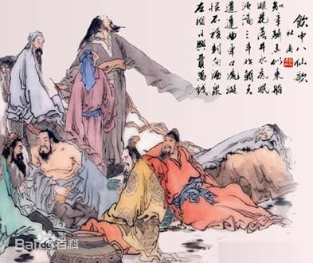
Drinking Behavior
饮中八仙歌
The Ode of Eight Immortals Indulged in Wine
杜甫[Du Fu]
知章骑马似乘船，眼花落井水底眠。
汝阳三斗始朝天，道逢麴车口流涎，恨不移封向酒泉。
左相日兴费万钱，饮如长鲸吸百川，衔杯乐圣称避贤。
宗之潇洒美少年，举觞白眼望青天，皎如玉树临风前。
苏晋长斋绣佛前，醉中往往爱逃禅。
李白斗酒诗百篇，长安市上酒家眠，天子呼来不上船，自称臣是酒中仙。
张旭三杯草圣传，脱帽露顶王公前，挥毫落纸如云烟。
焦遂五斗方卓然，高谈雄辩惊四筵。

Slide 7
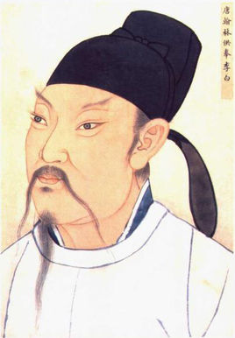
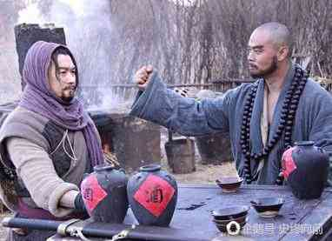
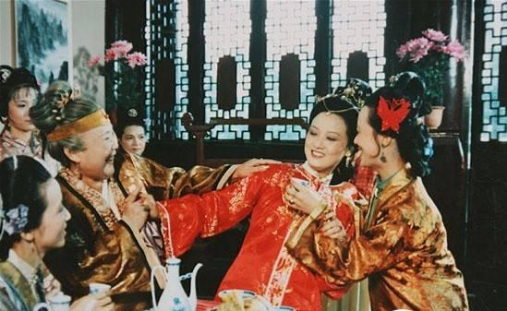
in Literature
poem：
《饮中八仙歌》；
李白[Li Bai]：
百年三万六千日，一日须倾三百杯。——《襄阳歌》
兴酣落笔摇五岳。——《江上吟》
烹羊宰牛且为乐，会须一饮三百杯。——《将进酒》
novel：
A Dream in Red Mansions，Water Margin：
There are a lot of scenes describing people drinking

Slide 8
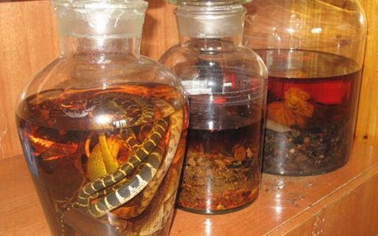
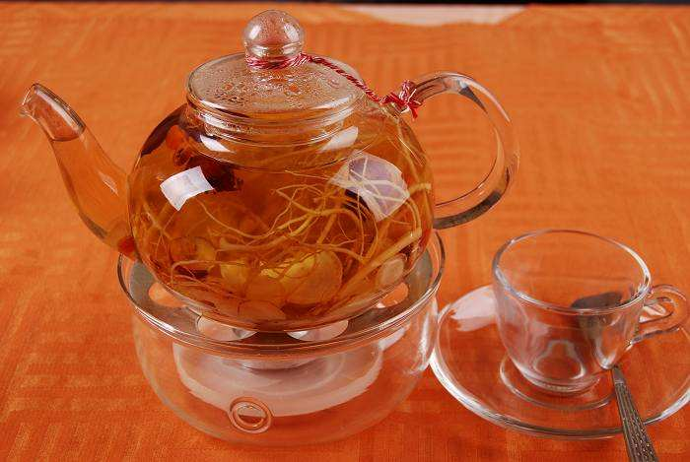
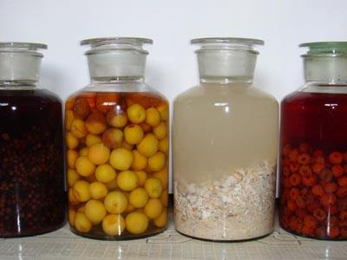
Regimen through Wine
People put some substances in the wine. After soaking for a certain period， people will drink the wine.

Slide 9
Traditional Method
heal
relieve
生葛根汁饮二升,便愈。
——《本草纲目》
云葛根： “…开胃下食,解酒毒。”
——《千金方》
酒七升着瓶中，熟朱砂半两着酒中，急塞瓶口，安猪圈中，任猪喙动，经七日取尽饮之，永断。
——《千金方》
嗜酒不已,毡中苍耳子七枚,烧灰投酒中饮之,即不嗜。
——《本草拾遗》
cut out forever
like

Slide 10
From Papaver to Opium
1
Introduction
2
Flower Admiration
3
Medicine
Papaver cultivation technique was introduced in China in late AD7.
In Tang dynasty, papavers were mainly used for flower admiration.
During the Song and Yuan dynasties, the medical function of papaver was highly valued and widely used .
Introduction
Opium Addiction
Opium was introduced in Ming dynasty.
In Qing dynasty, with the invention and dissemination of the mixed tobacco smoking method, opium began to be abused and became a drug to harm the society.
1
2

Slide 11
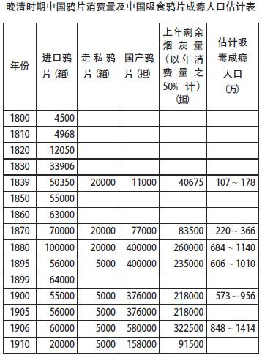
Opium Use and Addiction in Late Qing Dynasty
Lu Jikang(2014)
The data are extrapolated from History of Foreign Relations of The Chinese Empire, Customs Report, History of Drugs in China and so on.
The population in 1851 is 436 million.

Slide 12
First Opium War
China-UK
trade
opium
prohibition
opium
destroy
outbreak of the war
consequence of the war
In order to reverse the trade deficit with China, the UK began to smuggle opium into China.
The problem of opium addiction caused serious social problems, so the Qing government enforced the ban on opium.
Lin Zexu seized more than 20,000 boxes of opium and burnt them in the Humen beach.
Britain started the war on the grounds of invasion of private property.
After the first opium war, China and Britain signed the Treaty of Nanking.

Slide 13
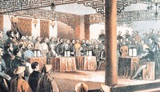
Second Opium War
After signing the Treaty of Tianjin, the UK, France and the US signed another treaty——《通商章程善后条约》 with the Qing government.
The opium trade was legalized in China.
This aggravated the social problems caused by the opium trade.

Slide 14
Five Minerals Powder
Five Minerals Powder (五石散), or Cold-Food Powder (寒食散), was a poisonous psychoactive drug popular during the Six Dynasties (220–589) and Tang Dynasty (618–907) periods of China.
Ingredients: stalactite(钟乳石), fluorite(紫石英), quartz(白石英), sulfur(硫磺), red halloysite(赤石脂)——《魏晋风度及文章与药及酒之关系》(鲁迅)

Slide 15
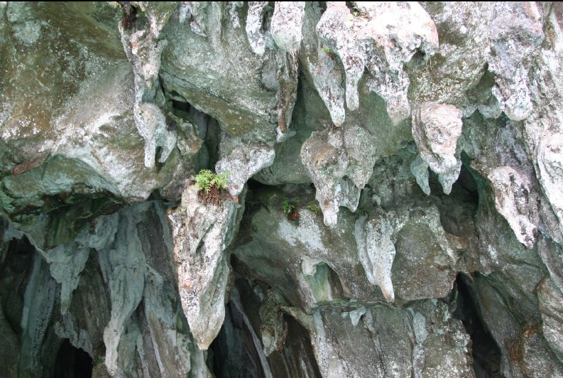
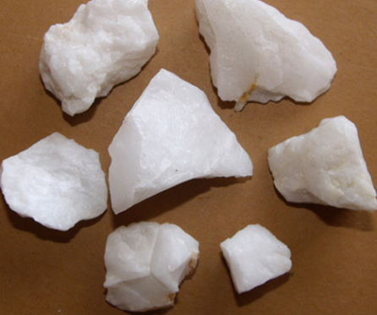
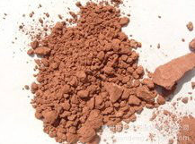
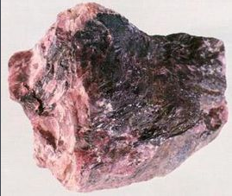
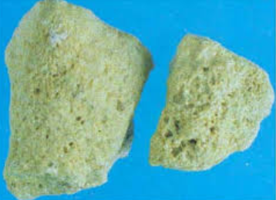
Five Minerals Powder
stalactite(钟乳石)
quartz(白石英)
red halloysite(赤石脂)
fluorite(紫石英)
sulfur(硫磺)

Slide 16
Five Minerals Powder
Effects:
Fever symptoms: Fever, needs “cold food”
Behavioural disorders: experience of depression and suicidal tendencies
Aphrodisiac(春药)

Slide 17
Five Minerals Powder
Skin troubles:
1. all kinds of "rottenness" of flesh;
2. cutaneous disorders like abscesses, ulcers, especially on the legs and on the back.

Slide 18
Five Minerals Powder
Influence on daily life:
Scholars generally associate the drug with the scholar-gentry social class
Wearing clogs（木屐） and loose clothes because their skin easily scraped
Prefer old clothes, many bugs on their body

Slide 19
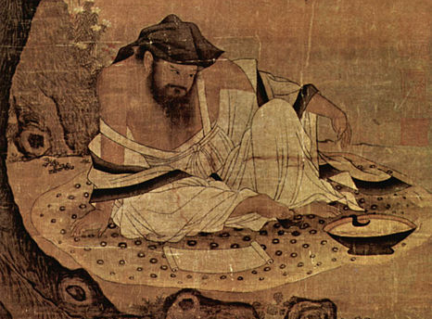
Tao Yuanming (365?–427)

Slide 20
Chinese alchemy
Chinese alchemy is an ancient Chinese scientific and technological approach to alchemy, a part of the larger tradition of Taoist body-spirit cultivation developed from the traditional Chinese understanding of medicine and the body.
Outer alchemy（外丹）

Slide 21
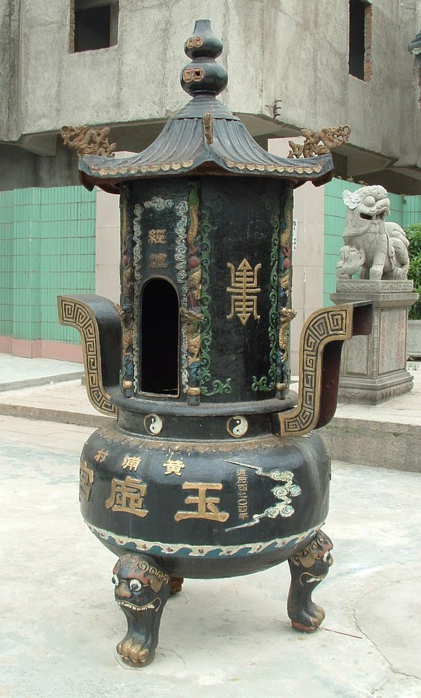
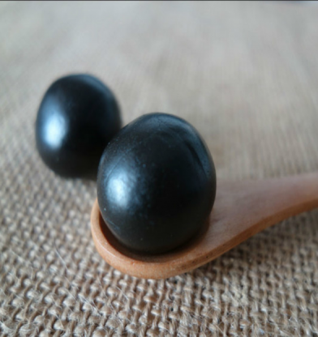
Chinese alchemy
Dan(丹)
Alchemy furnace(炼丹炉)

Slide 22
Chinese alchemy
Dan made from cinnabar(朱砂), realgar(雄黄), and other substances generally involving mercury(汞), sulfur(硫), lead(铅), and arsenic(砷) or else the animal and botanical products which are found in Chinese herbology and Traditional Chinese medicine.

Slide 23
Chinese alchemy
Usage:
Extend life of human
Aphrodisiac(春药)
Immortal

Slide 24
Chinese alchemy
Effects:
Mercury poisoning
Unconscious in daily life
6 Emperors of the Tang Dynasty died because of Chinese alchemy
Disturb people's lives and political situation

Slide 25
2
Current Situation
Drugs
Alcohol & Tobacco

Slide 26
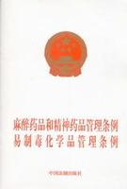
What are Drugs Literally?
China’s Criminal Law:
Narcotic drugs (麻醉药品) and psychotropic drugs（精神药品） which can make people addict to.
Narcotic drugs: Marijuana; opium; cocaine (highly addictive)
Narcotic and psychotropic drugs management law: 371 kinds of drugs
A relative concept:
whether they are abused or cause addiction.
Published in 2005

Slide 27
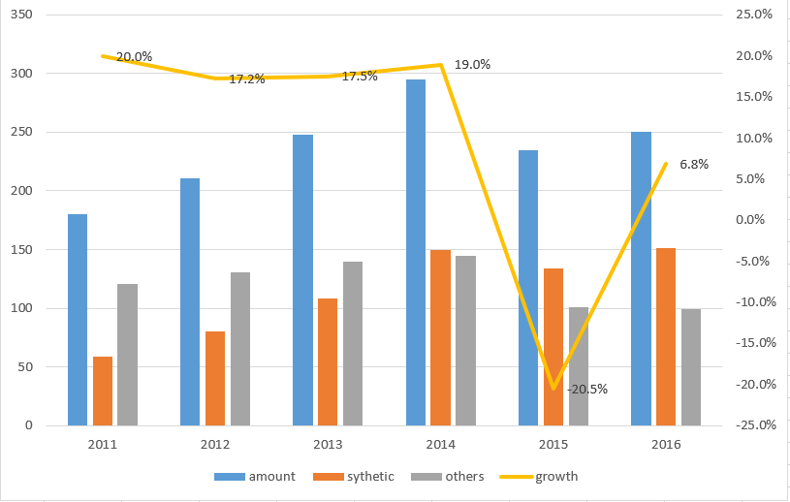
Prevalence & Incidence
10-thousand
Growth rate
2.5 million registered drug addicts
According to international common, the ratio of the registered and the unregistered is 1:5.
Average age: 28 y.o
14 million drug addicts
About one in every 100 people.

Slide 28
Prevalence & Incidence
10-thousand
Growth rate
Synthetic Drugs grows stably
with a 30% increase rate
Synthetic Drugs: chemical synthesis ecstasy(摇头丸); K powder; crystal meth(冰毒)
Traditional ones: extract from plants
opium; heroin

Slide 29
Prevalence & Incidence

Slide 30
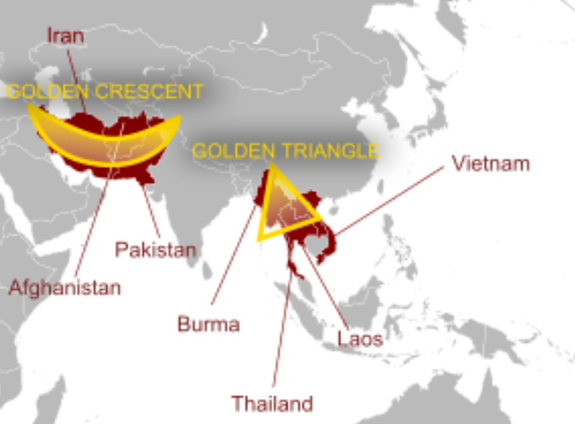
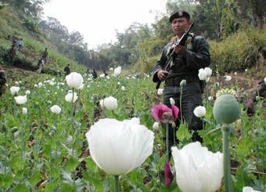
Origins & Channels
90% from Golden Triangle
Others from Golden crescent or made in China
Yunnan; Guangdong; Guangxi; Sichuan; Xinjiang
Mainly by internet.
Wechat pay/ Ali pay
Forums
Social media groups

Slide 31
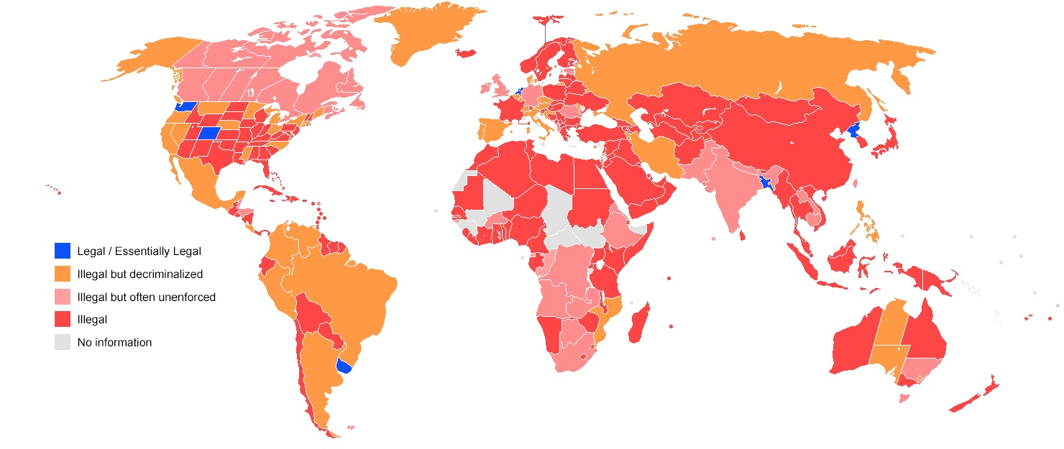
Strict Management
Whether Marijuana is legal or illegal ?
Source: Wikipedia

Slide 32
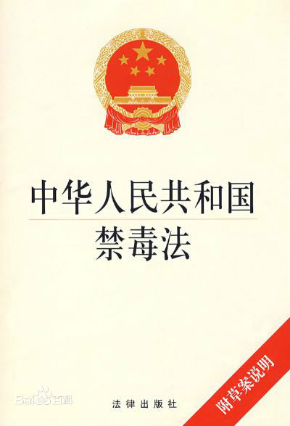
Strict Management
One of the strictest counties of drug control.
The dynamic control system:
A system that copies all the personal information of the registered drug addicts or others who have committed a crime of drugs before. Once the people in the system uses his/her own personal identification, (eg. Using a bank card; staying at a hotel etc.), the system will alert the near police to check the person in a short time.
Published in 2008

Slide 33
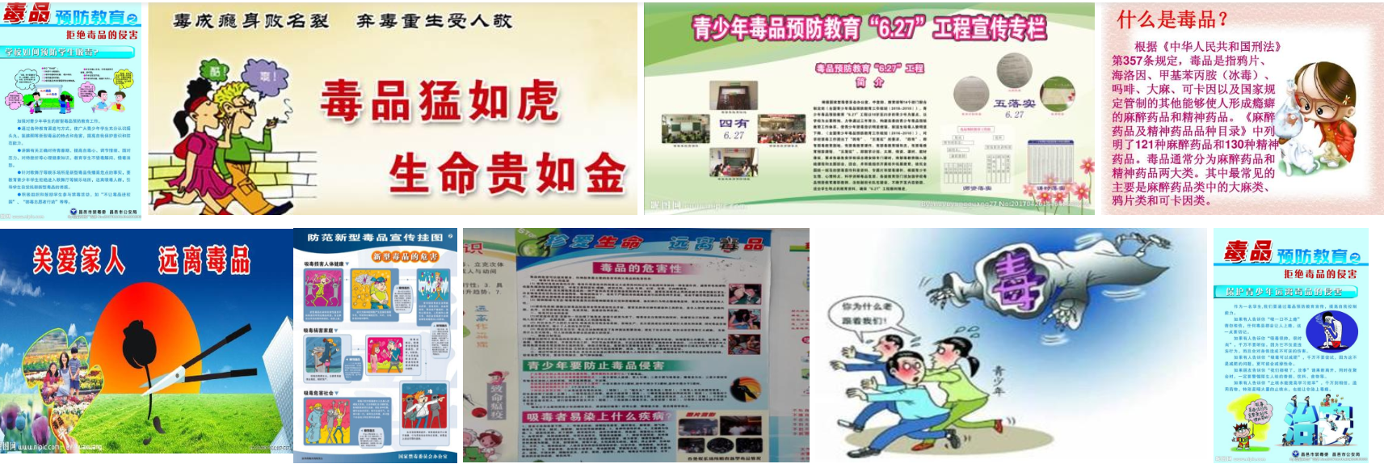
The public awareness
Education – emphasis on “SAY NO” attitude
Focus on Primary & Junior school
Exhibition / Theme class meeting / Lecture
Included in textbooks or exams.
e.g. Drug prevention knowledge should be permeated in Entrance examination for secondary school in Gansu Province

Slide 34
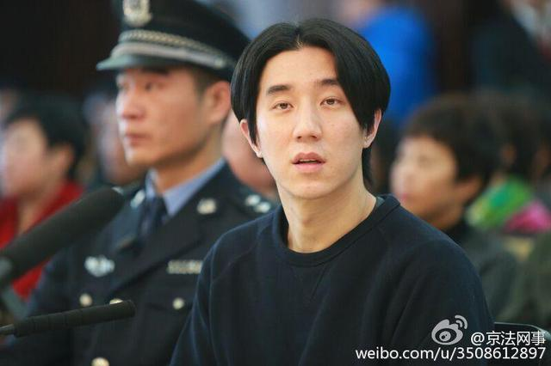


The public awareness
2. Drug abuse cases of public figures alert the public.
12 public figures were arrested and imprisoned in 2014.
Censorship: State Administration of Radio, Film and Television (广电总局) 2014
All the work which the misdeed public figures involved in are banned.

Slide 35
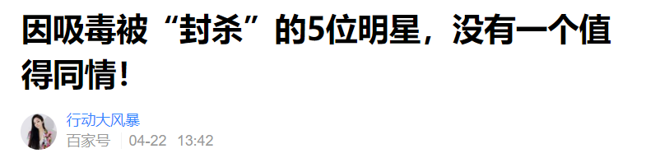

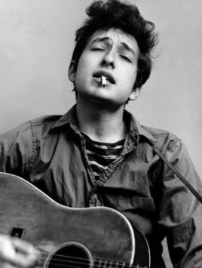
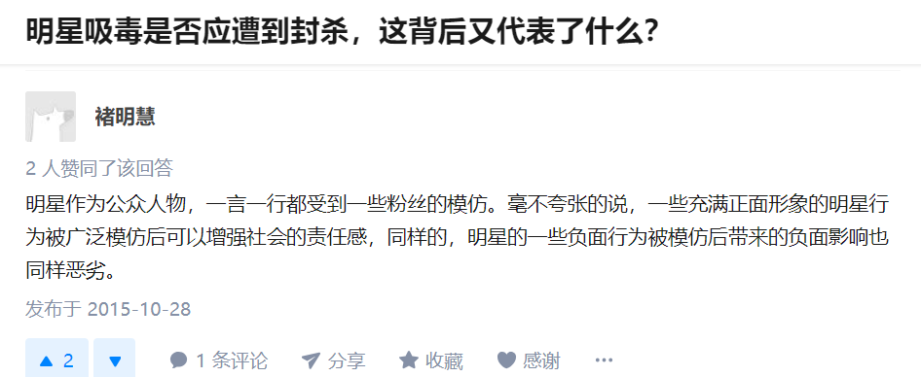
The public awareness
2. Drug abuse cases of public figures alert the public.
Comparison of Tendency of public opinion
They deserve it. Without empathy.
A mistake, but can be forgiven.
Doesn’t matter a lot. A way of recreation.
Obama, Bob Dylan, John Lennon, Lady Gaga etc..

Slide 36
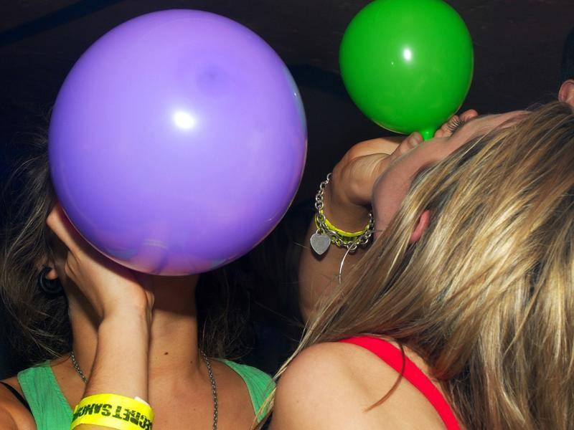
Another example ：“笑气”
Cannot stop laughing
GAS: N2O（Nitrous Oxide氧化亚氮）
Currently not included in the management law.
Traditional Use: anesthetic; food processing
Cause Paralysis.

Slide 37
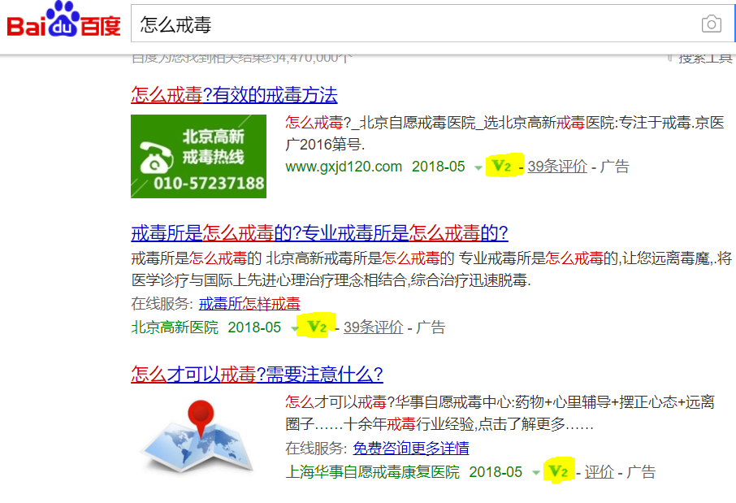
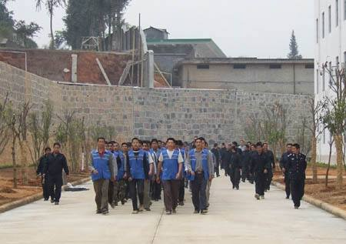
Measurement Access
2 ways to get treatment:
compulsory rehabilitation center --- managed by police / judiciary
amount: about 700 capacity: 350 000
Medical institutions – supervised by the health authorities
Internet access - ads

Slide 38

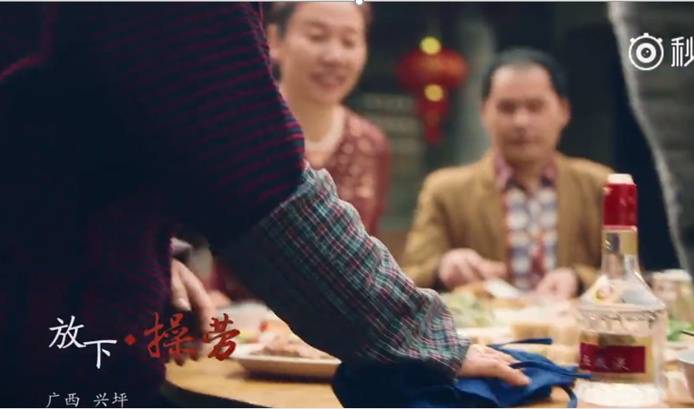
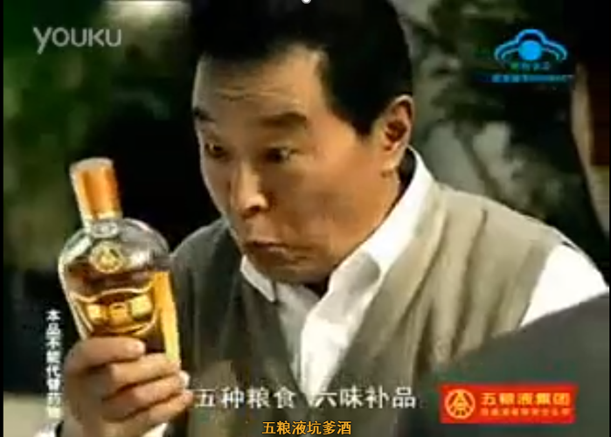
Alcohol advertising

Slide 39
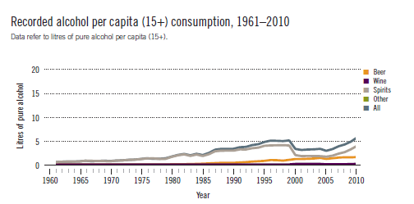
Recorded alcohol per capita consumption
Showed a general upward trend in all kinds of alcoholic drinking.

Slide 40
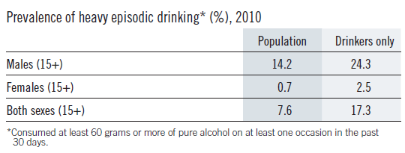

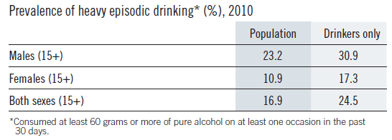
Prevalence of heavy episodic drinking
1.The rate of heavy episodic
in male is higher than
female.
2.Gender difference
is more significant in
China.

Slide 41
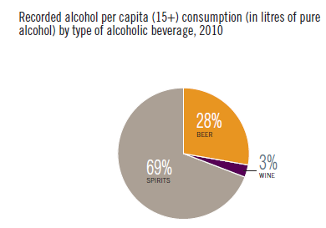
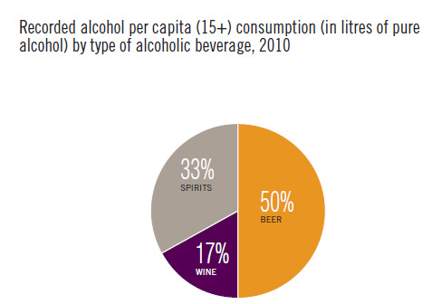
Recorder alcohol per capita
In China:
Spirits>Beer>Wine
In USA:
Beer>Spirits>Wine

Slide 42
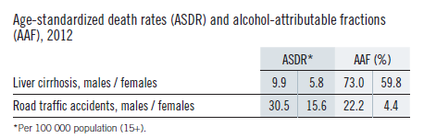
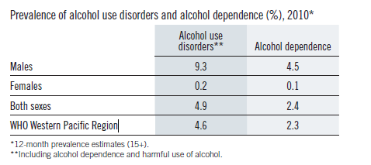
HEALTH CONSEQUENCES: MORTALITY AND MORBIDITY
In 2006, the WHO ranked China as the world's "hardest hit" of alcohol. According to the survey, more than 110,000 people die from alcohol poisoning each year , with more than 2.73 million people getting disability from alcohol.
Age-standardized death rates（ASDR)：
Death rate corrected so as to allow for the effects of the differences in age structure of a population.

Slide 43
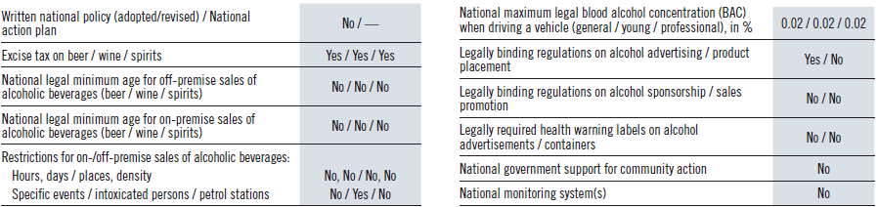
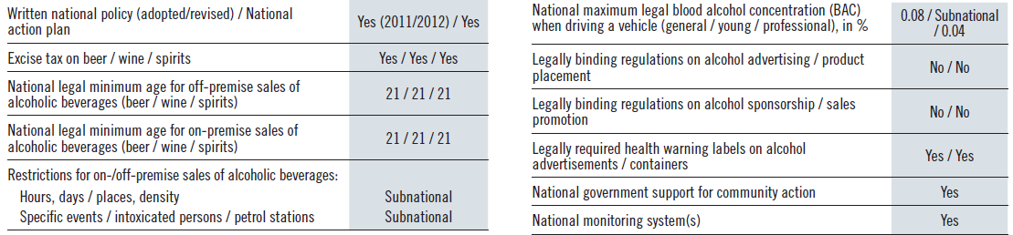
POLICIES AND INTERVENTIONS

Slide 44
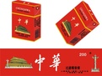
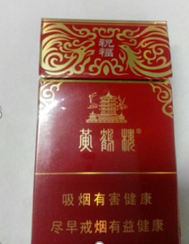
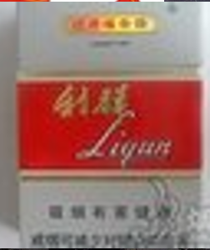
Tobacco
In China，there are about 350 million smokers, ranking first among all countries in the world.

Slide 45
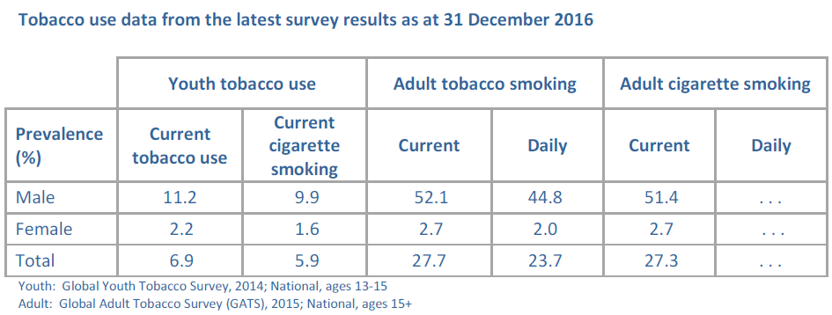
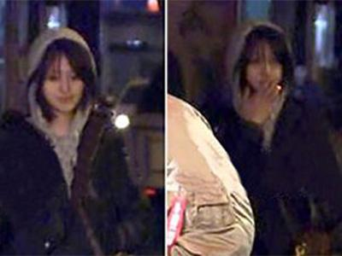


Prevalence of tobacco use
1.Male smoking
rate was
obviously
higher than
female smoking
Rate.
2.Gender difference
is more significant in
China.
（14.16）
（12.2）
（13.4）
（4.2）
（4.1）
（4.1）
（22.1）
（15.2）
（18.5）
（13.5）
（11.5）
（12.4）
（16.7）
（13.6）
（15.1）
（25.1）
（19.6）
（22.3）
（18.0）
（14.0）
（15.9）
（20.2）
（15.8）
（17.9）
（15.8）
（12.4）
（14.1）

Slide 46


Protect people from tobacco smoke

Slide 47




Treatment
USA:

Slide 48


点击此处添加标题
USA
International TV and radio/Local/International magazines and newspapers/
Billboards and outdoor advertising/Advertising on internet

Slide 49
THANK YOU

